Slide 1
AC-II UNIT 4
DIGITAL TO ANALOG AND ANALOG TO DIGITAL CONVERTERS
Digital-to-analog converters (DAC):Weighted resistor, R-2R ladder, resistor string etc. Analog to-digital converters (ADC): Single slope, dual slope, successive approximation, flash.

Slide 2
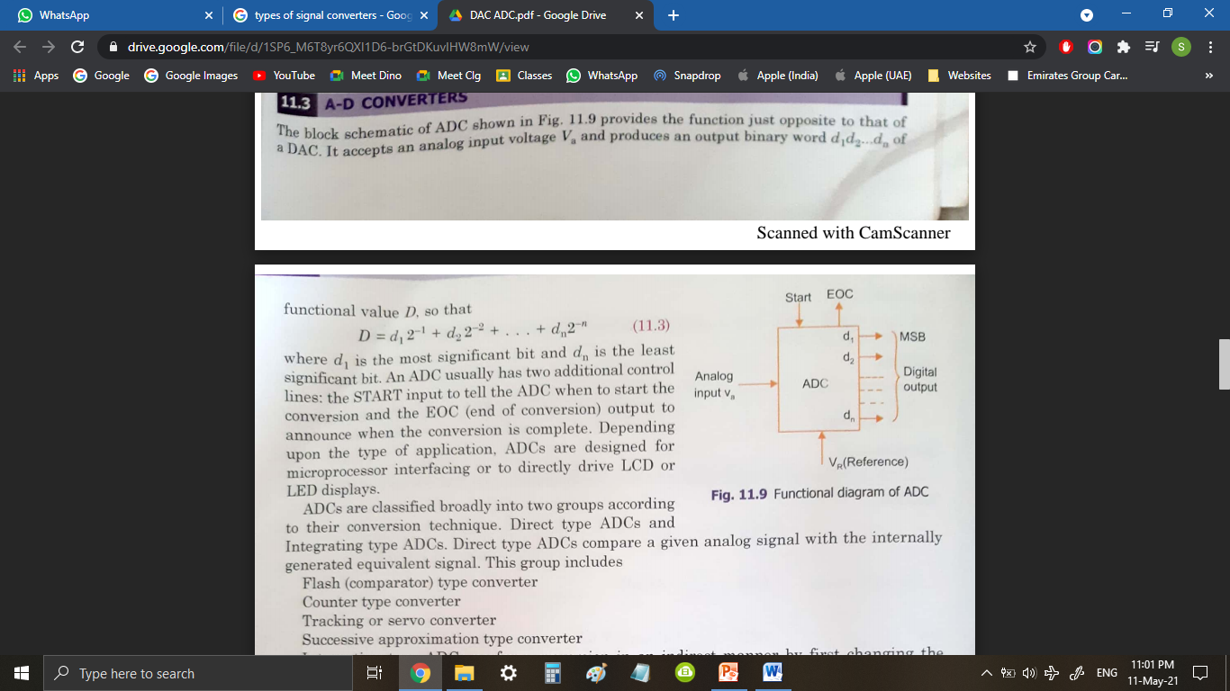
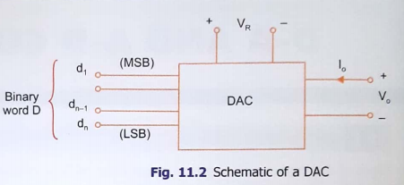
ADC:
Analog to Digital convertors are used to convert Analog Signals to Digital Signals.
DAC:
Digital to Analog convertors are used to convert Digital Signals to Analog Signals.

Slide 3
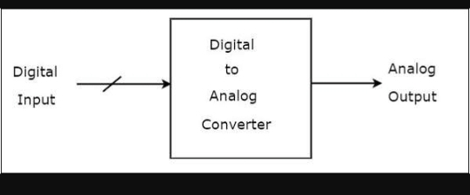
What is DAC?
DIGITAL TO ANALOG CONVERTER - n-bit digital input combined with reference voltage is given as input. It converts digital input into analog signal it can be either voltage or current.
2 TYPES OF DAC:
1. Weighted Resistor DAC
2. R-2R Ladder DAC

Slide 4
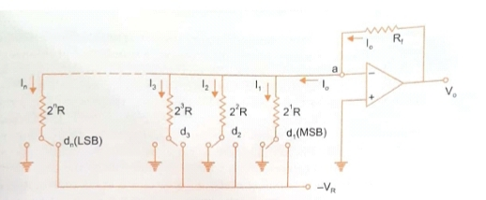
WEIGHTED RESISTOR DAC:
It uses summing amplifier with a binary weighed resistor
network
It has n binary inputs d1(MSB) ,d2, d3,…….dn (LSB)

Slide 5
CIRCUIT CONSIST OF:
It has n switches one for each bit applied to input .
It has a weighted resistor ladder
Inverting Summing amplifier that adds the current flowing in resistive network.
Switches will be connected to the ground when the input bits are equal to 0.
Switches will be connected to reference voltage when input bits are equal to 1.
Output voltage is the inverted sum of all input voltages.

Slide 6
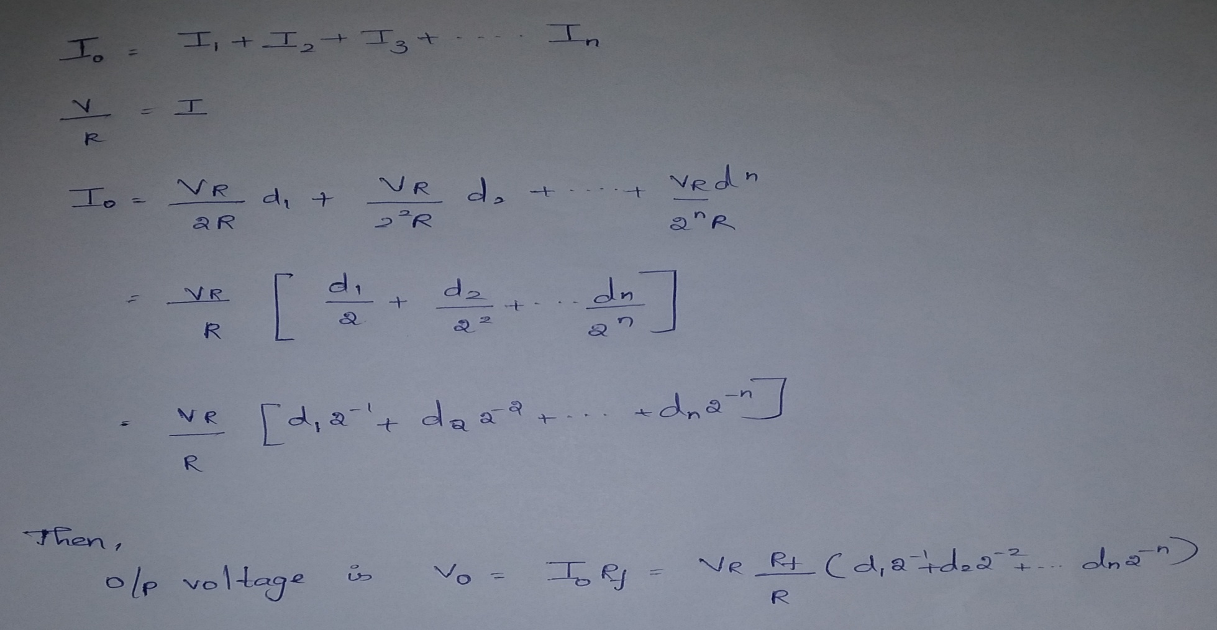

ANALYSIS

Slide 7
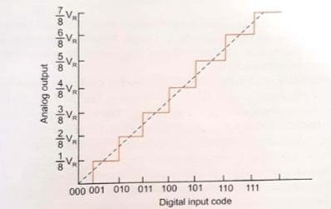
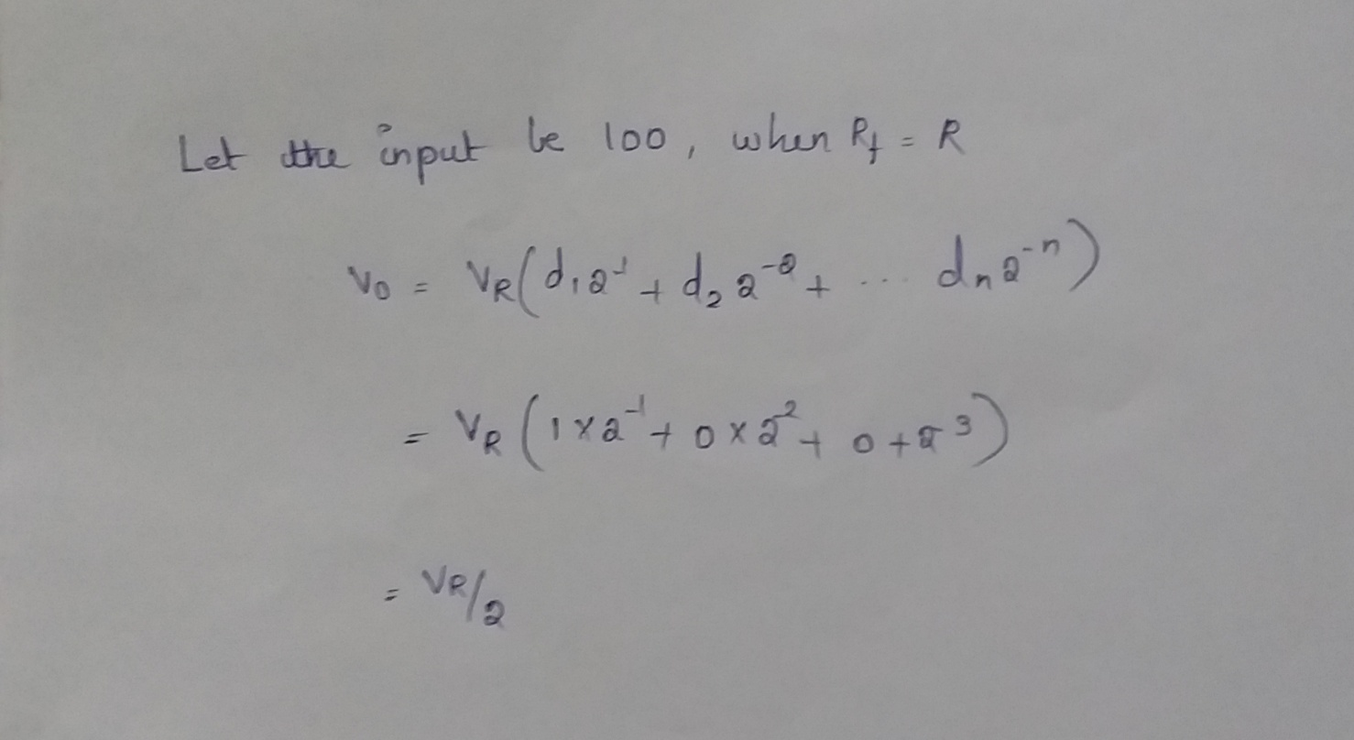
TRANSFER CHARACTERISTICS

Slide 8
DISADVANTAGE:
One of the disadvantages of weighted resistor is the wide range of resistance required .For 8bit DAC the resistance required are 2^0*R, 2^1*R......2^7*R.
The largest resistor is 128 times the smallest one, only for 8bit DAC. For 12-bit DAC, the largest resistance is 5.12MΩ.Fabrication of such large resistance in IC is not practical.
Also the voltage drop across such a large resistor due to the bias current affects the accuracy

Slide 9
R-2R DAC
R-2R Digital-to-Analog Converter is a data converter which uses two precision resistor to convert a digital binary number into an analog output signal proportional to the value of the digital number.
The R-2R resistive ladder network uses just two resistor values, one which is the base value “R” and the other which has twice the value, “2R” of the first resistor
The typical value of feedback resistor is Rf = 2R. The resistance R is normally selected any value between 2.5 kΩ to 10 kΩ.

Slide 10
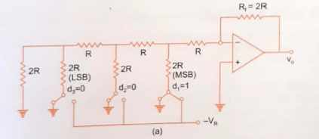
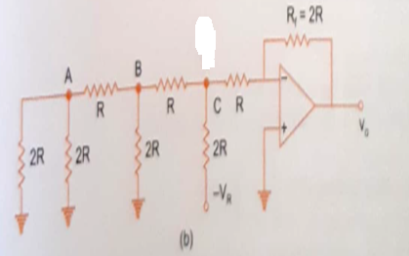
R-2R Ladder for switch position 100
Consider a 3-bit DAC, where the switch position corresponds to the binary word 100 (d1-MSB;d3 – LSB)
EQUIVALENT CIRCUIT

Slide 11
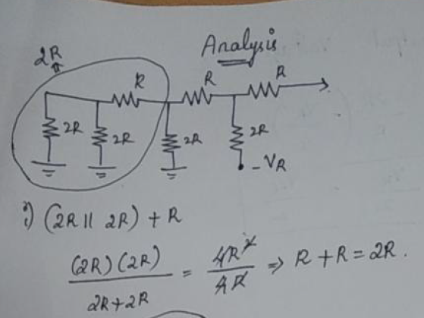
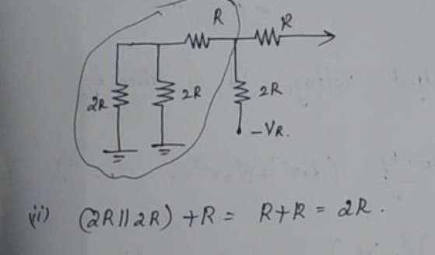
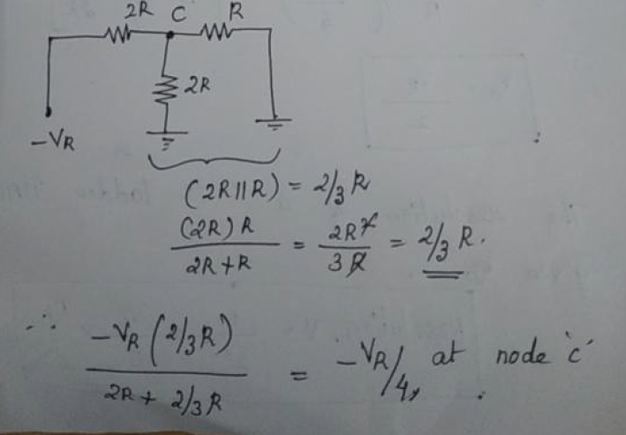
Analysis

Slide 12
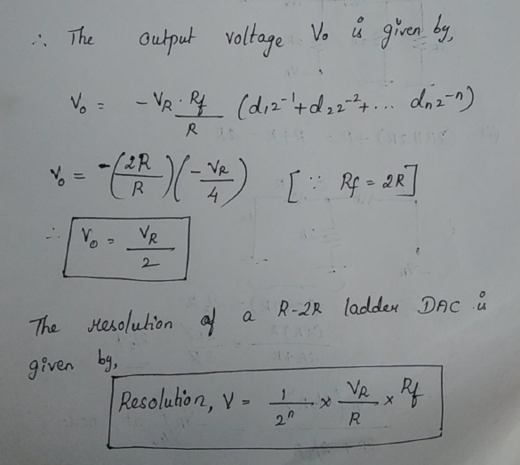

Slide 13
Advantages:
It is inexpensive and as it uses only 2 values of R, accurate fabrication is possible
It is fast and has fixed output impedance (R) regardless of number of bits
It is scalable to any desired number of bits
Disadvantages:
In this type of DAC, where there is a change in the input, changes a current flow in the resistor which causes more power dissipation which creates non-linearity in DAC.
With increasing output bits the circuit becomes larger.

Slide 14
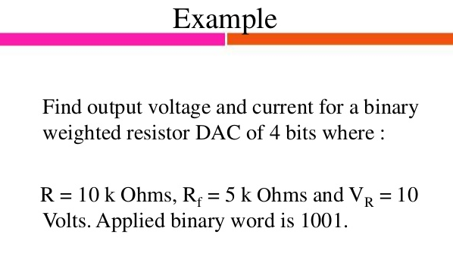

Slide 15
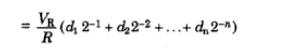
d1d2d3 d4 i/p ----1 0 0 1 Io = 10/10k(1/2 + 0 + 0 + 1/16) Io = 0.0006A Vo = Io Rf = 5.625V
Io

Slide 16
What output voltage would be produced by a D/A converter whose output range is
0 to 10V and whose input binary number is 0100 for a 4 bit DAC?
Output voltage= [(Output range)/2^{n}] x (Decimal equivalent of input binary)
= (10/2^4) * 4
= ?

Slide 17
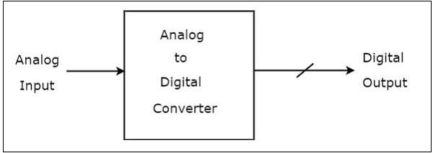
ADC
An Analog to Digital Converter (ADC) converts an analog signal into a digital signal. The digital signal is represented with a binary code, which is a combination of bits 0 and 1.
An Analog to Digital Converter (ADC) consists of a single analog input and many binary outputs. In general, the number of binary outputs of ADC will be a power of two.

Slide 18
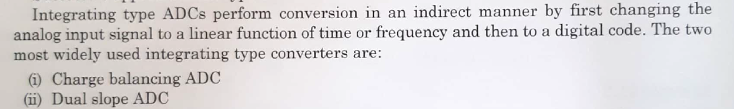
Two types of ADCs:
1. Direct type ADCs
2. Indirect type ADC
1.Direct type ADC:
If the ADC performs the analog to digital conversion directly by utilizing the internally generated equivalent digital (binary) code for comparing with the analog input, then it is called as Direct type ADC.
Counter type ADC
Successive Approximation ADC
Flash type ADC
2. Indirect type ADC

Slide 19
Outline of flash ADC:
Flash ADC is fastest among all ADC.
It takes only one clock cycle to have conversion of analog data into digital data.
It is also called parallel comparator.
Fast conversion speed is accomplished by providing 2^{n}-1 comparators and simultaneously comparing the input signals with unique reference levels
At each node of the resistive divider, comparison voltage is available, since all the resistors are of equal value, the voltage level available at the nodes are equally divided between VR and ground.
Typical conversion time of flash ADC is 100ns or less

Slide 20
Components of flash ADC:
High speed comparator (2^n -1)
Resistive voltage divider (2^n)
priority encoder (1)
n – desired number of resolution or bits.
For example:
n=3,
comparator=7
resistive voltage divider= 8

Slide 21
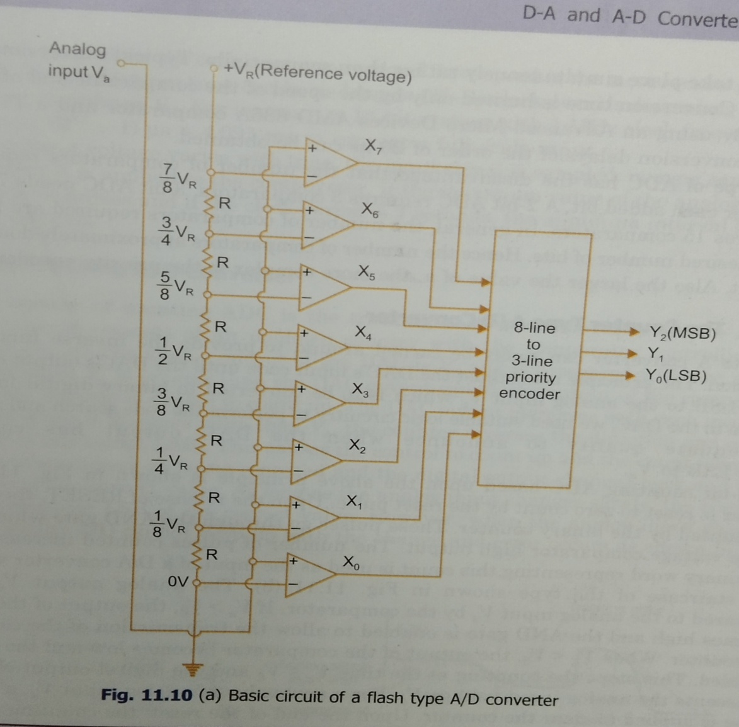
Structure of flash ADC:

Slide 22
Comparator and truth table:
Va
Voltage input | Logic output
Va > Vd | X = 1
Va < Vd | X = 0
Va = Vd | Previous value
+
X
Vd
-
Va – analog voltage
Vd - Reference voltage
If the non-inverting terminal input is high, the output of the comparator is 1
If the inverting terminal input is high, the output of the comparator is 0

Slide 24
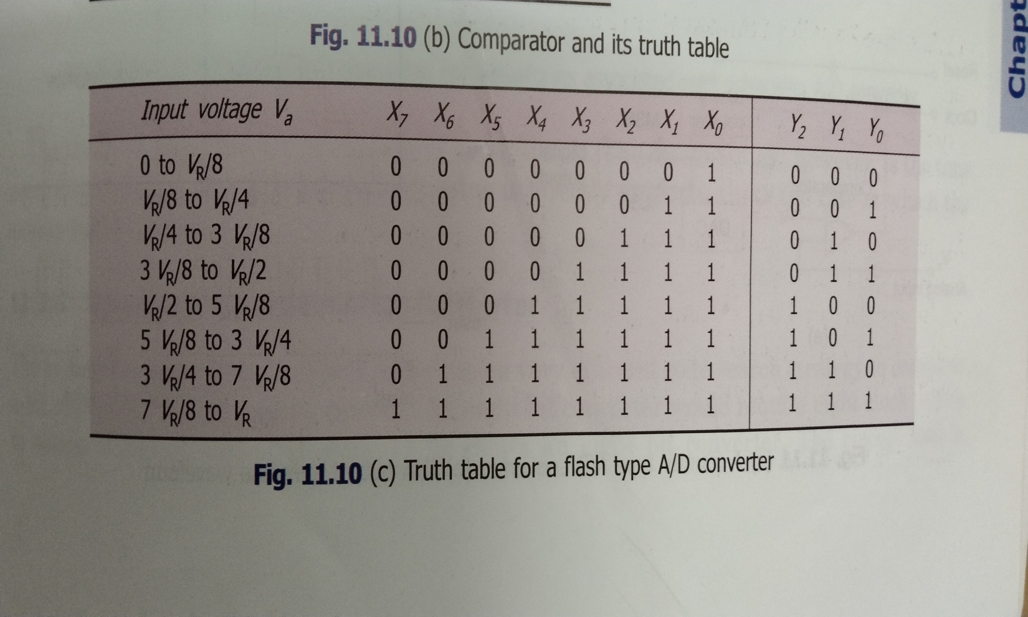
Truth table :

Slide 25
Advantages:
It is fastest ADC( Giga Samples per second)
Useful with large bandwidth input.
Disadvantages:
High power consumption.
Large size due to comparator( for 8 bits 255 comparator are used).
With more comparator, need of higher accurate matching network.

Slide 26
Successive Approximation ADC
The successive approximation technique uses a very efficient code search strategy to complete the n-bit conversion in just n-clock periods.
An 8 bit counter would require 8 clock pulses to obtain a
digital output.
The circuit uses a successive approximation register(SAR) to
find the required value of each bit by trial and error.
The circuit operates as follows:
With the arrival of the START command the SAR sets the MSB
d1=1 with all other bits to 0 so that the trial code is 1000
The output VDAC of the DAC is now compared with the analog input Vin.
If Vin is greater than VDAC then the comparator output is 1, this makes the SAR to set the next LSB to 1 i.e., 1100
If Vin is less than VDAC then the comparator output is 0, this makes the SAR to reset the MSB as O and sets the next LSB to 1 i.e., 0100

Slide 27
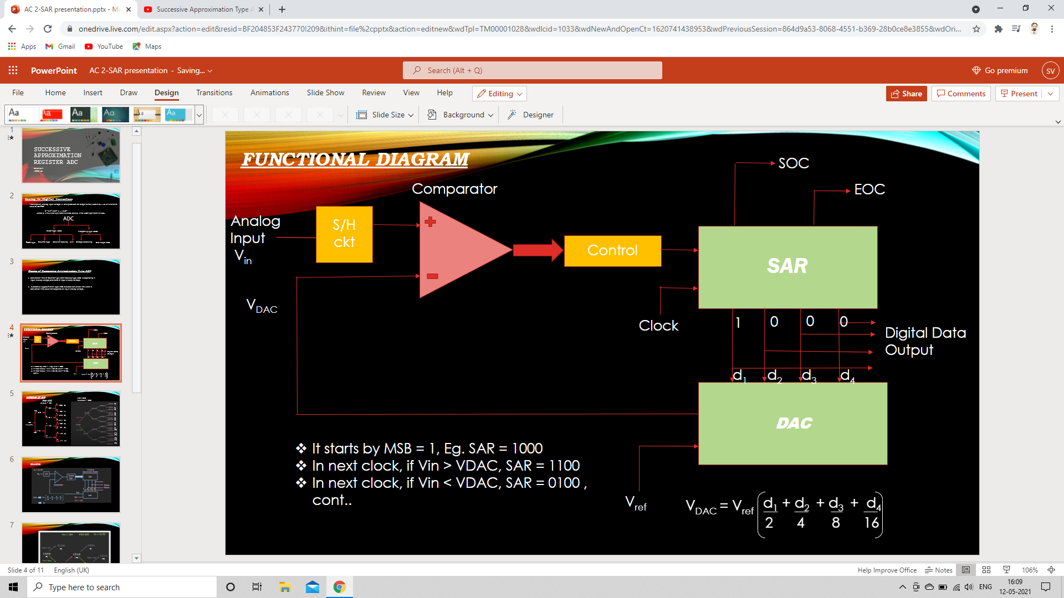
FUNCTIONAL DIAGRAM
START
Comparator
EOC
Analog Input
V_{in}
S/H
ckt
SAR
Control
V_{DAC}
Clock
1
0
0
0
Digital Data Output
d₁ d₂ d₃ d₄
DAC
It starts by MSB = 1, Eg.SAR = 1000
In next clock, if V_{in} > V_{DAC}, SAR = 1100
In next clock, if V_{in} < V_{DAC}, SAR = 0100 , cont..
V_{ref}

Slide 28
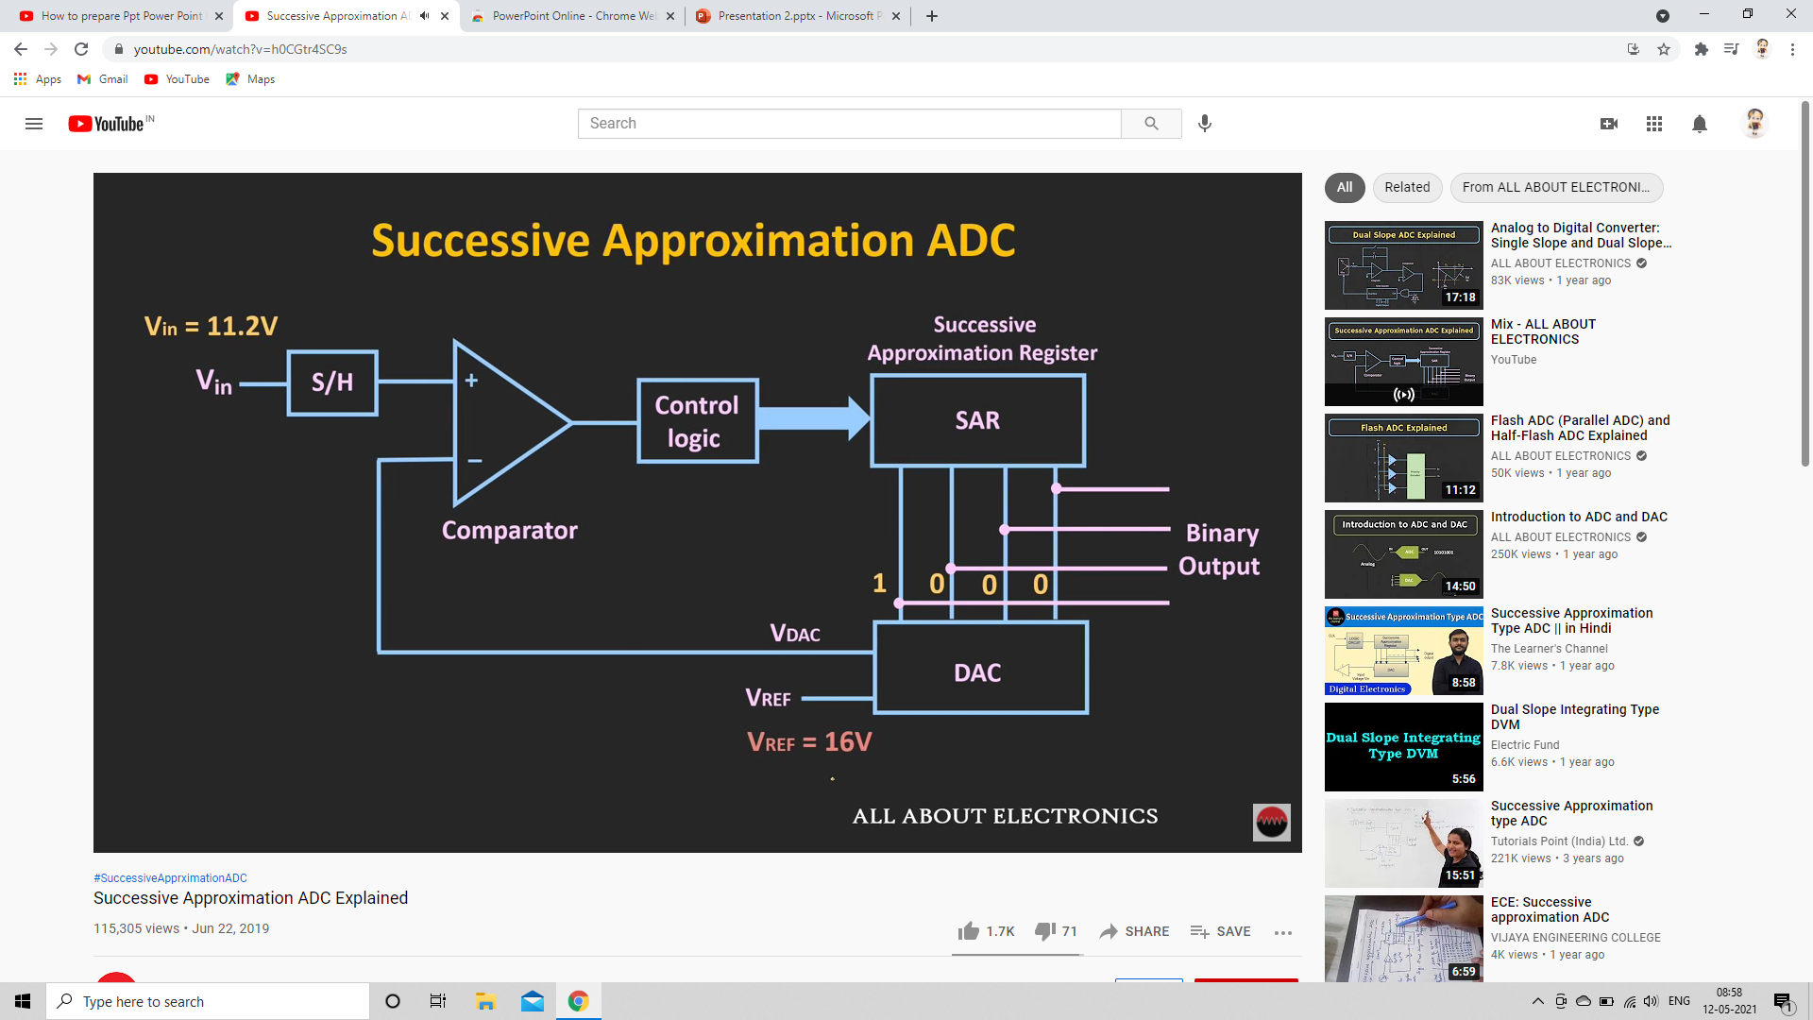
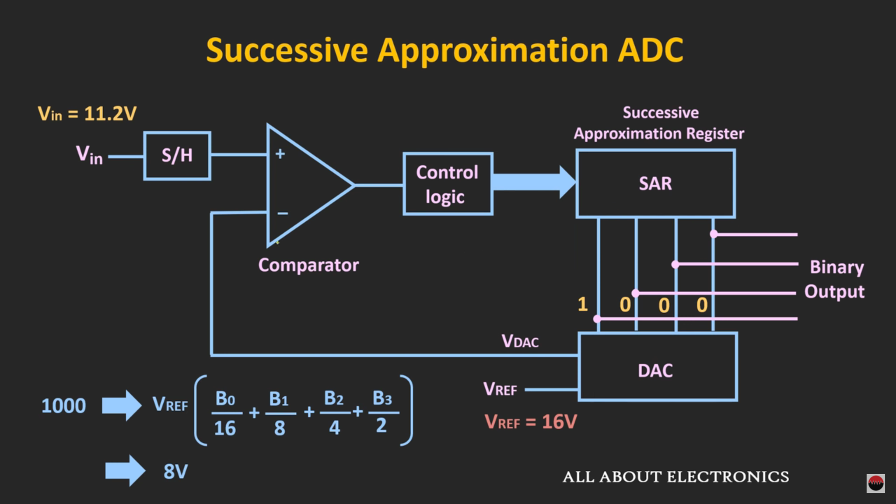
EXAMPLE :

Slide 29
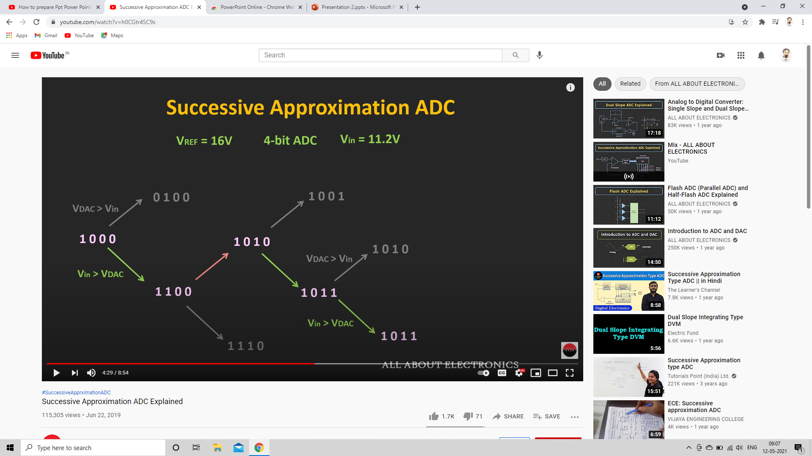
Conversion Tree
(4) (9)
(10)
(11)
(8)
(12)
(10)
(13) (11)

Slide 30
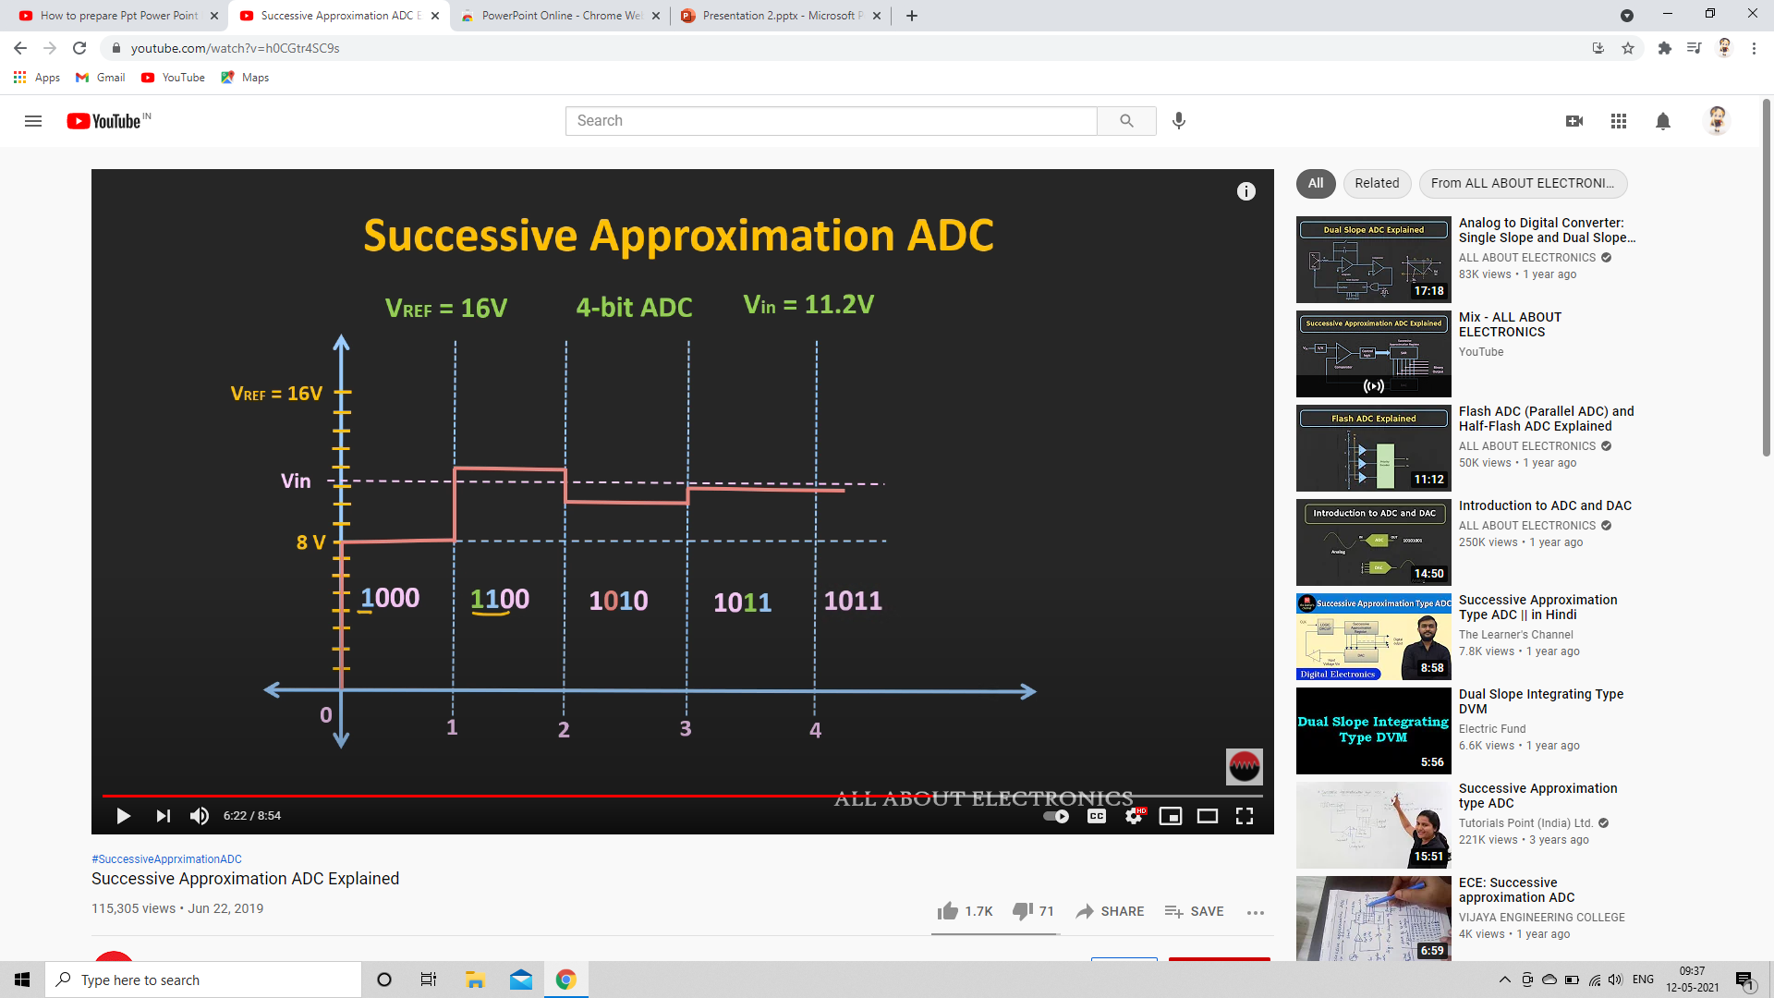
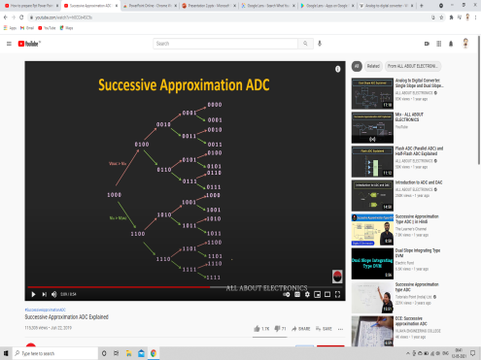
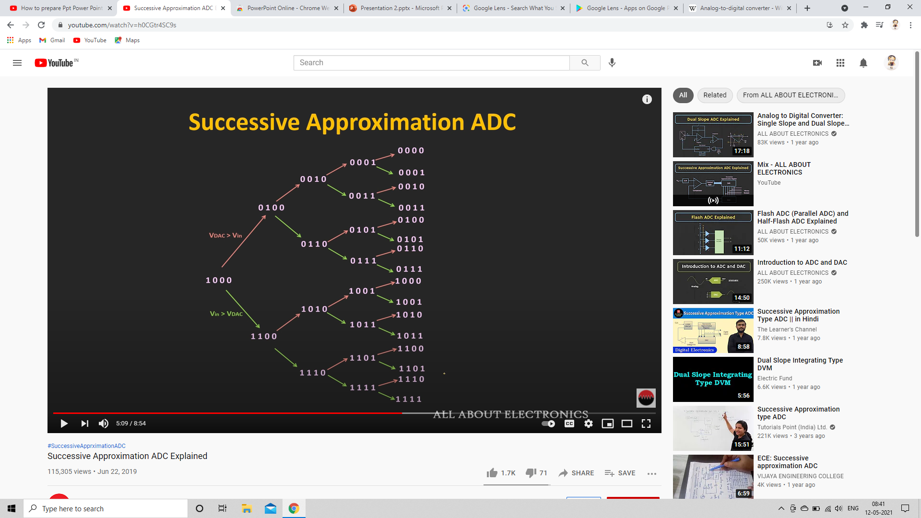
Time Domain

Slide 31
Conversion Time : (Independent of the input voltage)
T_{c} = N T_{CLK}
Resolution : Up to 20 bits (Eg.ADS8900B)
Conversion Speed : Up to 10 Mega Samples per Second(MSPS)
_{(Eg.LTC2368)}

Slide 32
ADVANTAGES OF SAR ADC :
High Accuracy
It uses very efficient code searching strategy called binary search.
Low latency Time
Easy to use
Drawbacks OF SAR ADC :
Design complexity
cost of production.

Slide 33
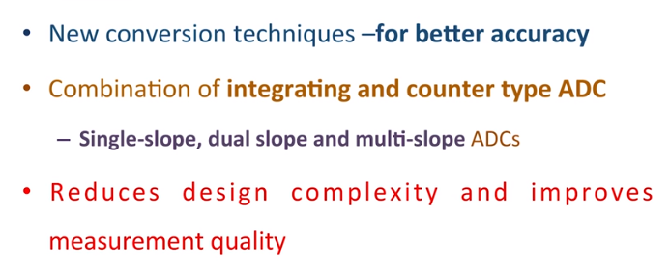
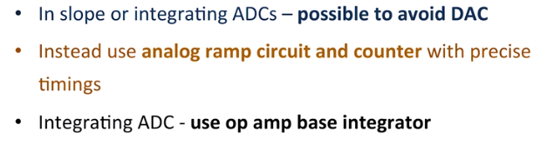
Need for single slope and Dual slope ADC

Slide 34
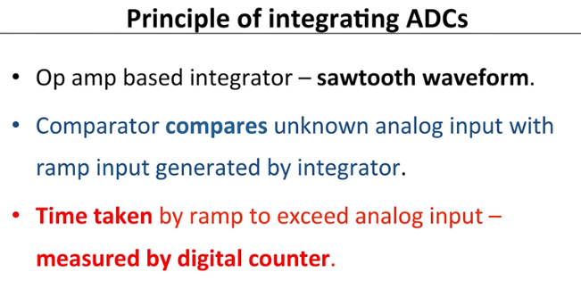

Slide 35
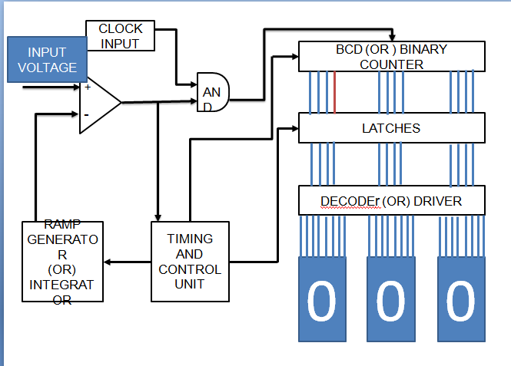
SINGLE SLOPE ADC

Slide 36
The single slope ADC mainly consists of comparator, Ramp generator, AND gate and Counter
COMPARATOR
A comparator is an electronic circuit, which compares the two inputs that are applied to it and produces an output. The output value of the comparator indicates which of the inputs is greater or lesser.
In single slope ADC, the input voltage is given to the non inverting terminal, the ramp generator output(Vref) is given to the inverting input, For non inverting comparator,
INPUT AND REFERENCE VOLTAGE | OUTPUT OF THE COMPARATOR
Vin> V ref | 1
Vin< V ref | 0
Vin = V ref | 0

Slide 37
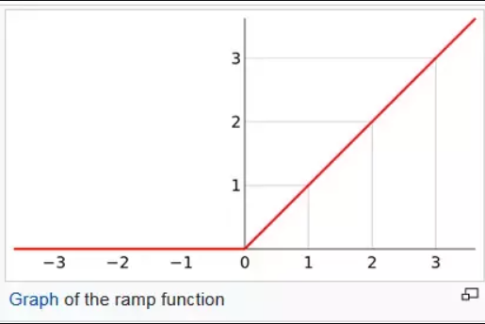
RAMP GENERATOR
A ramp generator is a signal generator which generates a ramp waveform. This waveform increases steadily as the capacitor is being charged until it hits its peak and then decreases even more dramatically as the capacitor is discharged

Slide 38
Let us take an example input voltage as 4V,at first (Vref)ramp generator output is zero, it is compared with the input voltage, then the comparator output is one; since(Vin>Vref)
It is given to AND gate input, the other input to AND gate is clock signal, if both the inputs are 1, then the output of AND gate is also 1
This enable the counter to count, this process continues till Vin =Vref, in this condition Comparator output is zero, then AND gate output is also zero,so it doesn’t enable the counter, the stored value in the counter gives the digital value of the given input votage.

Slide 39
Thank you

